Slide 1
Creating a “Lottery Experience of the NOW”
Practical and scalable PoP strategies for brand development, conversion, and ROI

Slide 2






Context
Me: Background in creating content to move audiences
Our Practice: Media at Retail. A fantastic laboratory for testing experiences
aimed at amplifying offerings and changing behaviors real-time.
The Premise: Apply shopper marketing and contextual banking insights to
the practice of Lottery Merchandising at POS. Unlock the power of physical locations as brand outposts & product amplifiers.
Notes:
Who I am – a storyteller – focus has always been on creating content to move audiences
I started in documentaries,
& spent the last 12 years working in the toughest laboratory in the world – brick and mortar retail.
Our company has been deploying communication networks (screens & mobile solutions) in physical locations for over 20 years
Today we will briefly explore how the insights we’ve gained in physical retail can be leveraged for the banks –the physical branch. We’ll discuss the parallels between the pressures that retail and banking are facing, and highlight experience strategies that move the needle for both
We’ll take what we’ve seen working in retail, and tie it back to the banking industry. Today we will tap into the power of physical location, leveraging content experiences and key consumer triggers in order to build deeper brand connections, increase engagement, and drive more revenue.

Slide 3


















About STRATACACHE
Based in Dayton, Ohio, with 17 offices worldwide
Divisions include Carmanah Signs, PRN, and SuperLumin
Leader in digital communication and signage solutions @ scale
Key verticals: Gaming, Retail, Banking, and QSR
Notes:
A little more about Stratacache – we are a leader in place based digital solutions – signage & mobile communication technology.
With a deep portfolio of trusted media management systems, screen, mobile and content acceleration technologies, we specialize in deploying and managed services for very large scale networks.
We have dedicated teams focused on key industry verticals – they include Banking, Retail, Gaming and QSR’s.
We are differentiated in the industry in that we not only deploy networks – we manage them with end-to-end services.. The circle on the right gives you a sense of how we serve our clients – from network strategy & experience design, to deployment and management as well as brand partnerships.
We are focused on the key moments of truth – when customers engage with media and go from maybe to yes. And todays customers are tough!

Slide 4
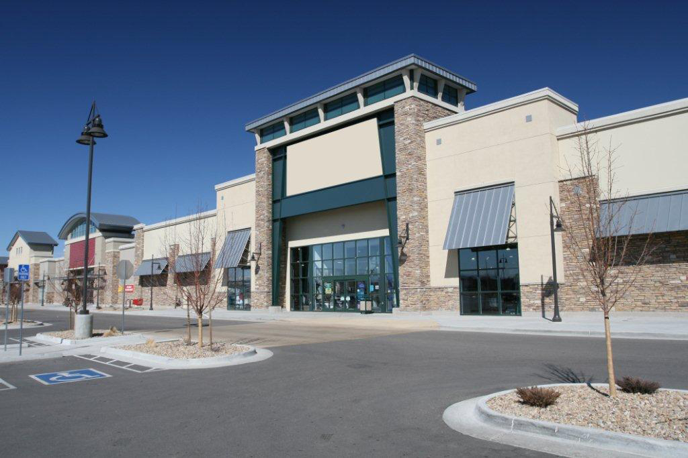


Brick and Mortar Retail Under Pressure
Showrooming
Amazon velocity
Rising costs
Brick and mortar growth lagging
Big box stores need reinvention
E-commerce accounts for
7.3% of total US retail sales
Notes:
The pressure comes in the form of showrooming & ease and customization of digital competition
This is affecting physical spaces. The pressures on the left are real….but we know stores are not going away. E commerce only accounts for 7.3% of total retail sales.
It’s a very exciting time to be in physical retail, because although stores are not going away, they ARE changing. They are responding to today’s consumer in 4 main ways:

Slide 5
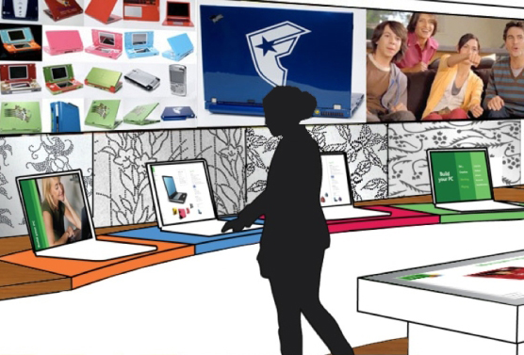
The In-store Experience is Critical
Providing customers with a compelling brand experience will become a primary role of the store, eclipsing traditional shopping
Deloitte – The Next Evolution Store 3.0
Notes:
Because visiting the store better be a good experience – and provide unique value:
The physical store is most salient brand outpost. Put simply - it’s the most critical physical embodiment of the brand. It’s real and tactile, and It’s got to give me something that I cant get online, as well as everything I can!
Every industry is facing this seismic shift of physical spaces in this virtualized on-demand economy. We hear a lot about the store of the future. We know it will be…..

Slide 6

Banking Also Under Pressure
Shifting Sands | Deep Trust
79% of consumers view their banking relationship to be transactional – up 8% since 2014 18% of Millennials switched their primary bank within the past 12 months – compared to 10% of customers 35 to 54 and 3% of people 55 and older | 88% of bank customers still use branches 86% percent of consumers trust their bank over all other institutions to securely manage their personal data
Source: Accenture 2015 Banking Survey, Banking Shaped by the Customer
Notes:
Because physical branches are under pressure…..
This data is taken from Accentures-2015-North-America-Consumer-Banking-Survey
Shifting sands-
79% of consumers view their banking relationship to be transactional – up 8% since 2014
“my branch” less relevant: 81% would remain with their bank if their branch closed (43% of them moving to another branch)
18% Millennials switched their primary bank within the past 12 months – compared to 10% of customers 35 to 54 and 3% of people 55 and older
But clearly, the branch is here to stay!
88% of bank customers still use branches
88% of customers satisfied with their banks’ performance
86% percent of consumers trust their bank over all other institutions to securely manage their personal data

Slide 7
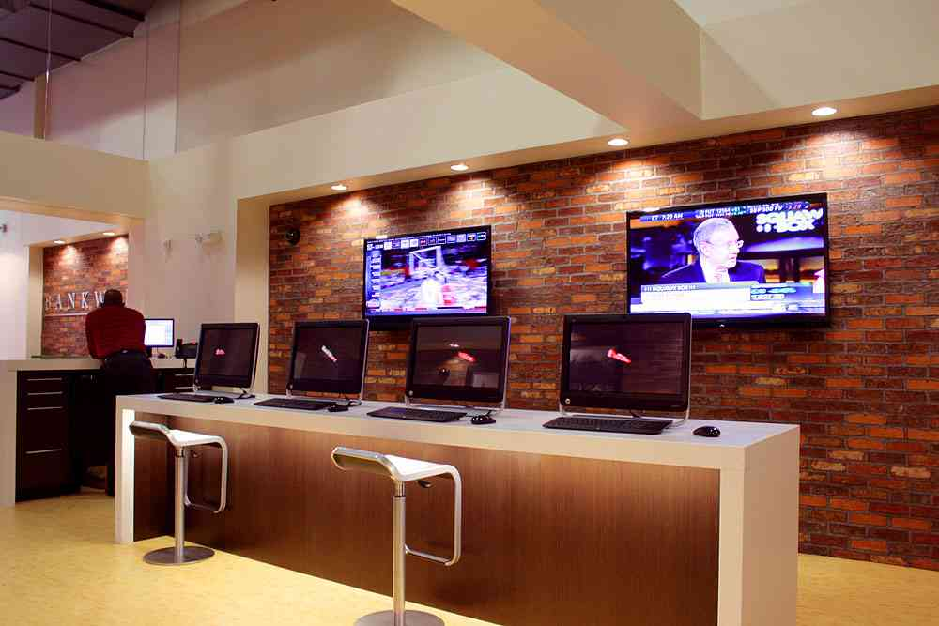
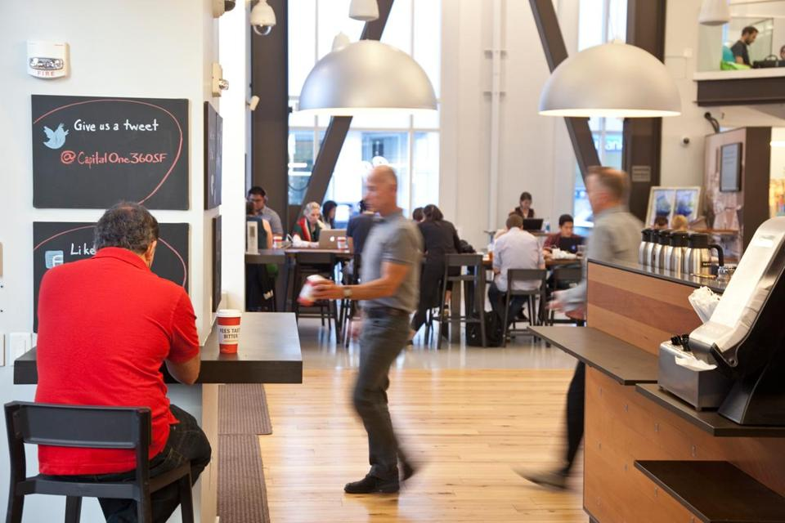

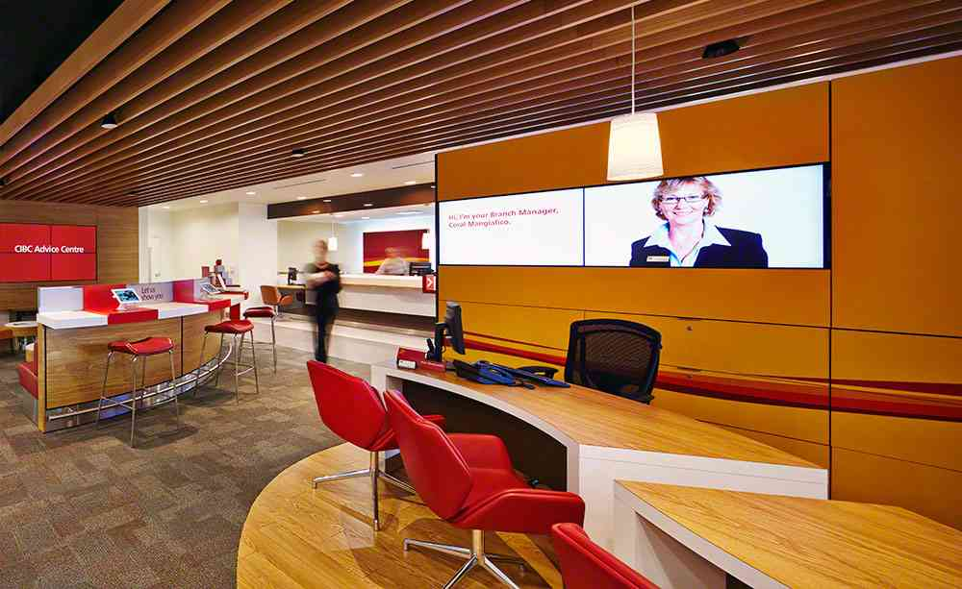
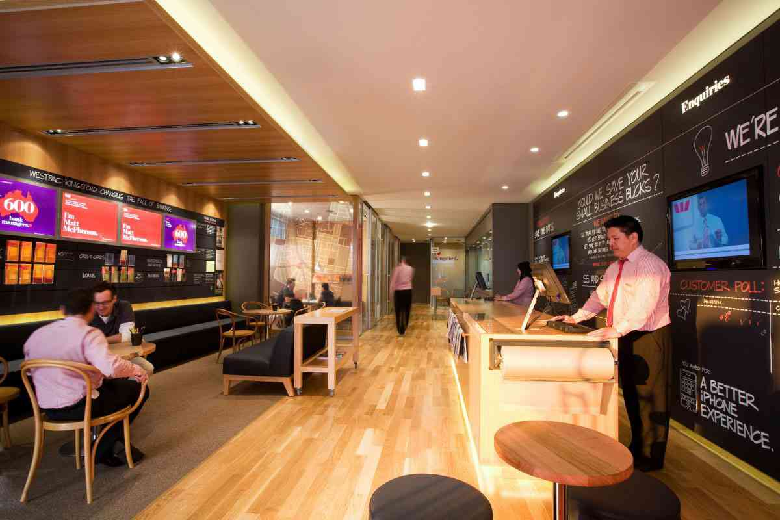
Trying New Approaches at the Branch
Tech Bars
Coffee Houses
Yoga Studio
Notes:
And new approaches to the physical spaces in banking are being tested – be it branch as tech bar, coffee house, or even branch as yoga studio!

Slide 8
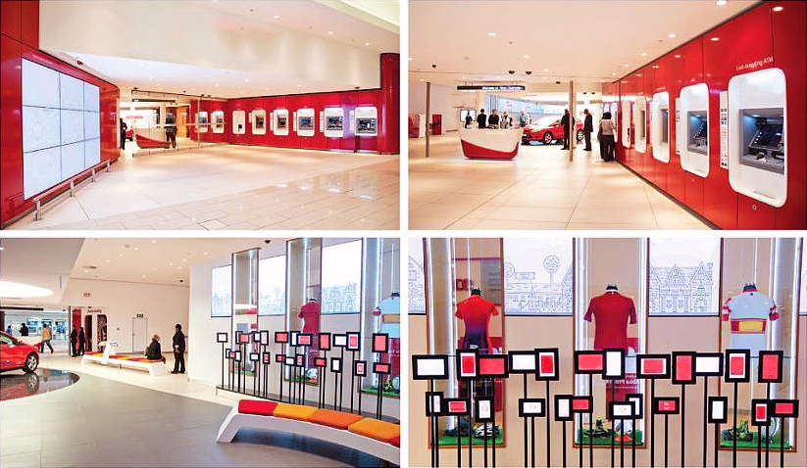
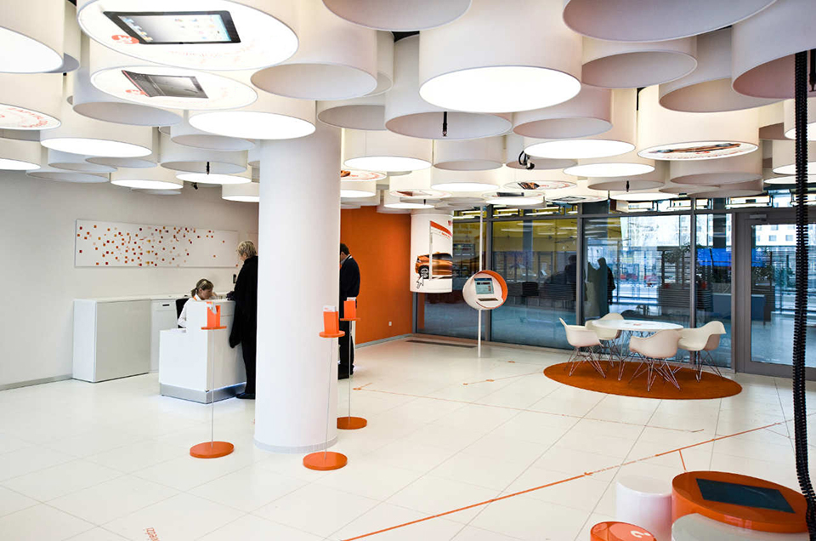
The “Branch of the Future”
Notes:
This is true of the bank of the future as well – it will be more theatrical, more immersive. More tactile and more interactive.

Slide 9

The Fallacy of the ”____ of the Future”
Museum-like
Not enough meaningful data generated
Doesn’t address strategy of scale
Danger of box checking mentality
Lacks the rigor and discipline associated with meaningful POC initiatives

Slide 10



The Future is Today – The Digital Store/Digital Branch is Here
We’ve reached a tipping point of scaled deployments
The technology is stable, cost effective, and highly evolved
Retail and Banking industries are seeing ROI (and ROO)
1.4million+
300k+
500million+
devices
venues
daily consumers
Notes:
220K retailers in US, 30K in Canada. IN more locations than all lottery retail deployments. More than there are lottery retailers in NA.

Slide 11
Digital Engagement Changes Behavior and Delivers ROI and ROO
Banking | Retail
77% of people who recall digital signage perceive their bank as innovative | 60% Average Ad Recall vs. 17% Network TV 18% Radio 20% Print Ad
Increase in product awareness from 22% to 45% | Digital Signage reduces perceived waiting times at checkout by as much as 35%
30% increase in credit card sales | 28% average sales lift from Product TV
Source: Platt Institute. Checkout TV Ad Recall Study, The Nielsen Company 2010. Radio, and Print Recall - Media Dynamics 2006, TV Recall TV Dimensions, 2014 Information/comparisons to be used directionally. Rosetta Stone® deployment in Best Buy.
Notes:
In the bank of today, new communication and engagement solutions are delivering tangible results:
Customers percieve their bank to be more innovative
They are more satisfied and spend less time waiting in line
There is an increase in engeagment with financial advisors
They know more about avaialble producs and fundimentally this knowledge translates to deeper engagement and stronger ties.
We feel that there’s never been a more exciting time to be in Banking –because the bank of the now is HERE!

Slide 12




Strategic Underpinnings for Architecting Place Based Experiences
WHO & WHY
WHERE
WHAT
HOW
Customer Knowledge
Micro-Segmentation
Channel Allocation Strategy
Physical vs. Digital
Experience Architecture
Winning Moments
Driving Loyalty & Daily Relevance
Transparent Meaningful Offerings
Notes:
The most successful banks are doubling down in these five areas:
Know the customers – micro segmentation
Reimagine the experience – test, learn, and scale what works
Change the distribution mix – evolve the role of the branch, Grow digital
Deepen and sustain loyalty - Examine brand promise, transparency & meaningful loyalty offerings
Evolve into everyday banks – Audit your entire value proposition to ensure consistent daily relevance

Slide 13
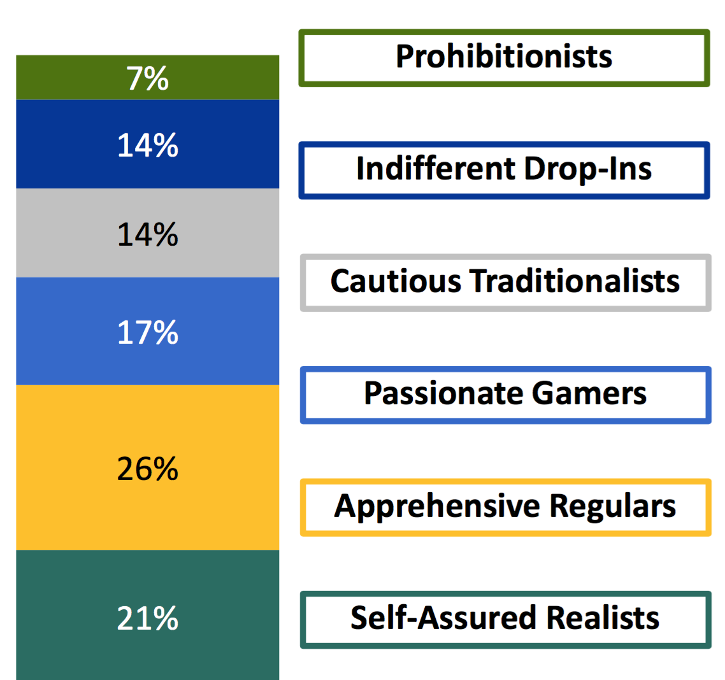
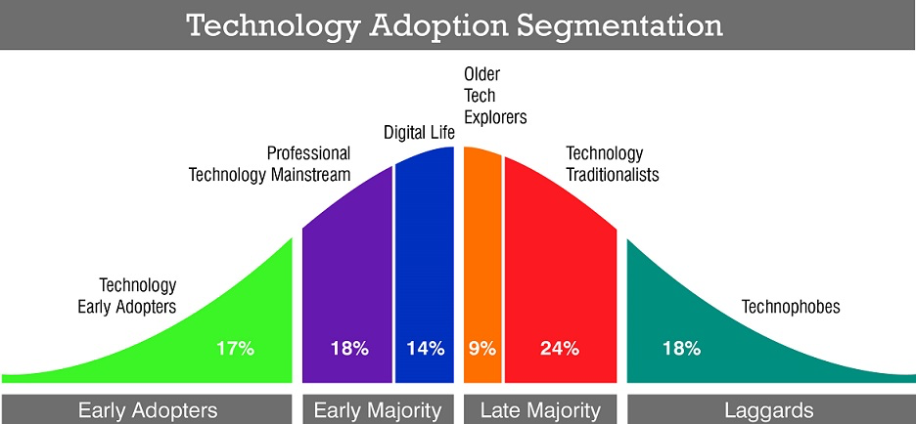
WHO
Customer Knowledge – Common “Micro-segmentations”
LOTTERY PLAYERS
TECHNOLOGY SHOPPERS

Slide 14
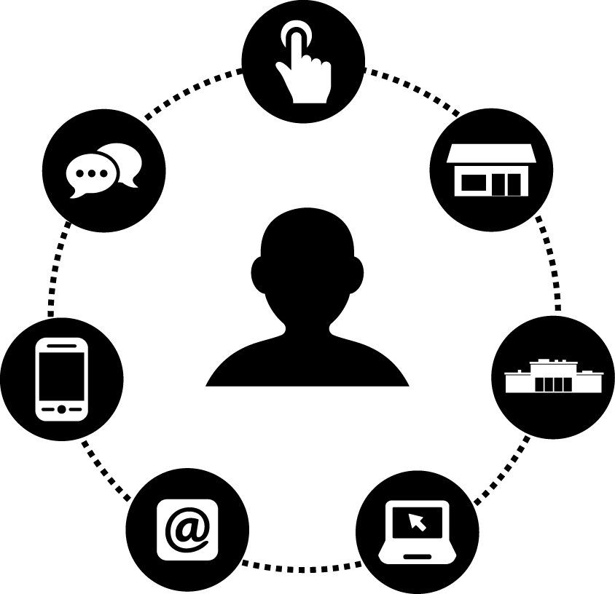
WHERE
Channel Allocation Strategy

Slide 15
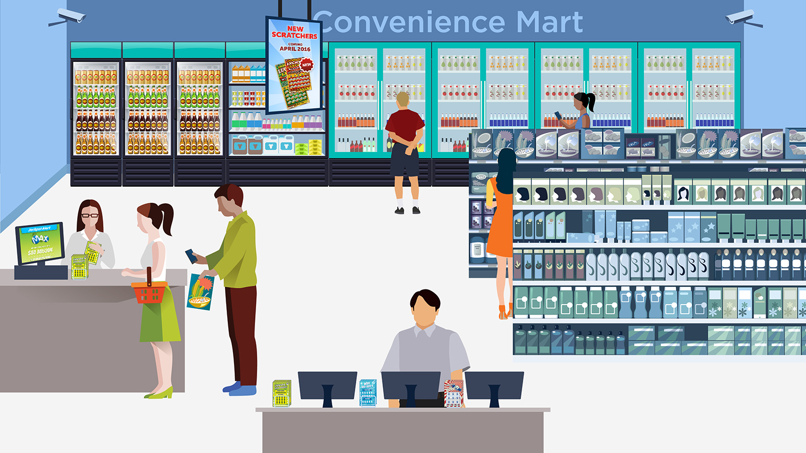
WHAT
Thinking in terms of Winning Moments
Attract and Motivate
Connect and Sustain
Engage and Delight

Slide 16

HOW
Leveraging Content Triggers – Jackpot Alert
Strategic content engages, activates, and moves the needle.
Notes:
LORI: reduce to 3 types of content for 3 different zones: alerts – jackpot amounts, responsive merchandising, new products (can fold in seasonal)
But technology is just a vessel – screens don’t do the heavy lifting. Smart content built around an editorial calendar that unifies all local and national marketing, good works, and localized efforts is the key – creating an editorial calendar (distinct from a marketing calendar) and leveraging key customer triggers like
What’s new
Seasonality
Good works
and Branch of the community
Is what really moves the needle!

Slide 17

HOW
Leveraging Content Triggers – Good Works/Community Impact
Notes:
LORI: reduce to 3 types of content for 3 different zones: alerts – jackpot amounts, responsive merchandising, new products (can fold in seasonal)
But technology is just a vessel – screens don’t do the heavy lifting. Smart content built around an editorial calendar that unifies all local and national marketing, good works, and localized efforts is the key – creating an editorial calendar (distinct from a marketing calendar) and leveraging key customer triggers like
What’s new
Seasonality
Good works
and Branch of the community
Is what really moves the needle!

Slide 18

HOW
Leveraging Content Triggers – New or Seasonal Products
Notes:
LORI: reduce to 3 types of content for 3 different zones: alerts – jackpot amounts, responsive merchandising, new products (can fold in seasonal)
But technology is just a vessel – screens don’t do the heavy lifting. Smart content built around an editorial calendar that unifies all local and national marketing, good works, and localized efforts is the key – creating an editorial calendar (distinct from a marketing calendar) and leveraging key customer triggers like
What’s new
Seasonality
Good works
and Branch of the community
Is what really moves the needle!

Slide 19
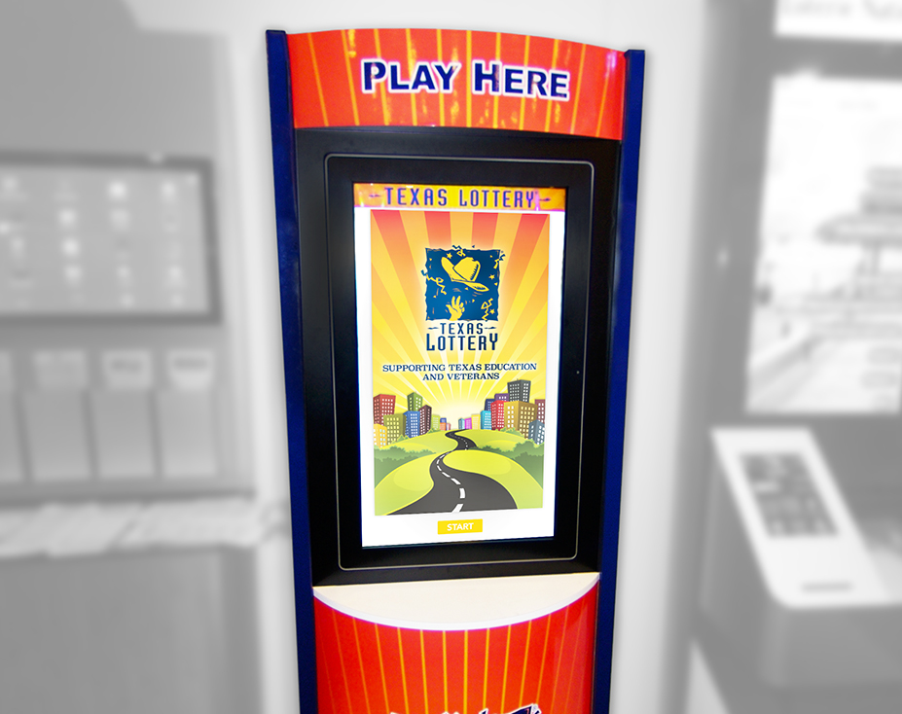
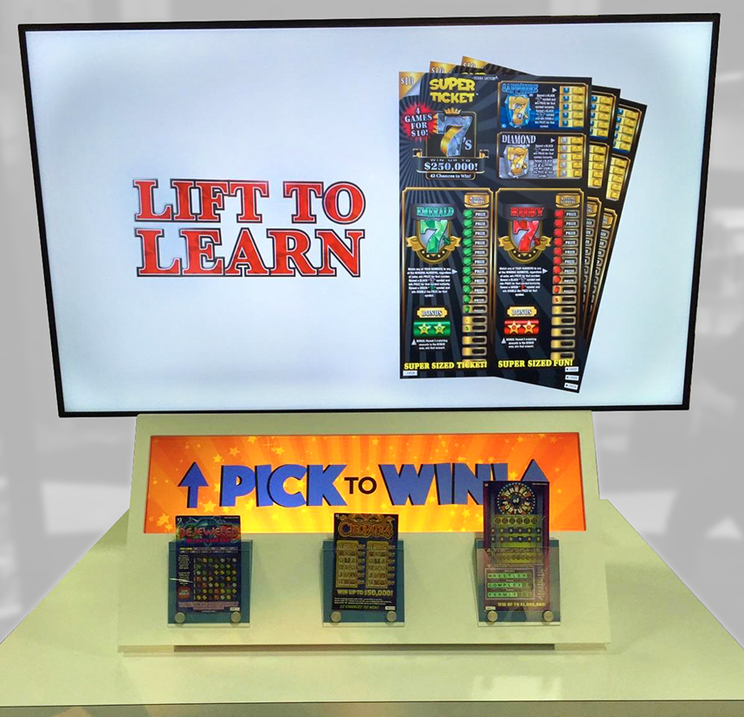
HOW
Leveraging Content Triggers – Responsive Merchandising
Strategic content engages, activates, and moves the needle.
Notes:
LORI: reduce to 3 types of content for 3 different zones: alerts – jackpot amounts, responsive merchandising, new products (can fold in seasonal)
But technology is just a vessel – screens don’t do the heavy lifting. Smart content built around an editorial calendar that unifies all local and national marketing, good works, and localized efforts is the key – creating an editorial calendar (distinct from a marketing calendar) and leveraging key customer triggers like
What’s new
Seasonality
Good works
and Branch of the community
Is what really moves the needle!

Slide 20
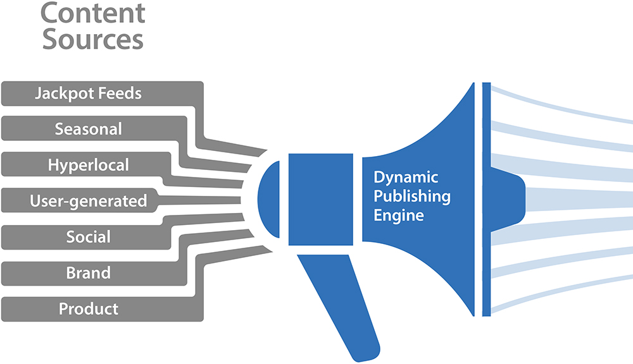
HOW
Contextual Real Time Rules Based Engine
Branch | Channel | Day of Week | Time of Day | Audience | Conditions
Notes:
And powering it all is a flexible rules based content engine – an engine that serves the right content, and the right time, to the right customers.
Today it’s easy to leverage smart HTML formats to created customized dynamic content that changes based on
Branch | Channel | Day of Week | Time of Day | Audience | Conditions

Slide 21
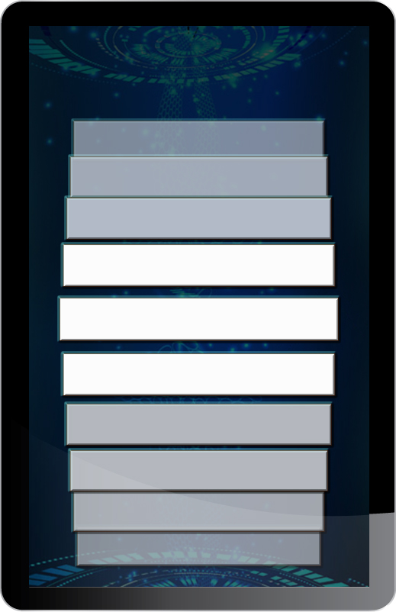
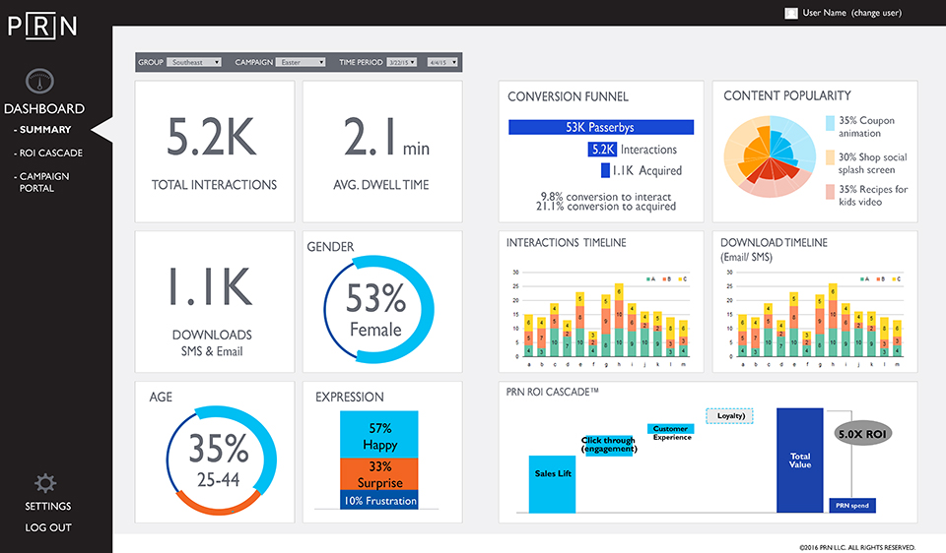
HOW
Leverage the Real Estate for Experimentation and Data Collection
          Goal
            Optimize Physical Like a Website
DASHBOARD
Trackable Data
Swipes, Clicks
Offers to Phone
Forwards
Impressions
Demographics
Dwell
Facial Expression/Sentiment
Contact Information
Carrier Information
Content A/B Testing
Notes:
And today’s all-in one signage and interactive solutions can collect so much data on campaign efficacy – campaign data, consumer interaction data, engagement data – In the bank of the now, customer behavior can be better understood, and we can use those real time insights to optimize the physical space almost like a website. Predictive and proscriptive analytics can be monitored via customized dashboards

Slide 22
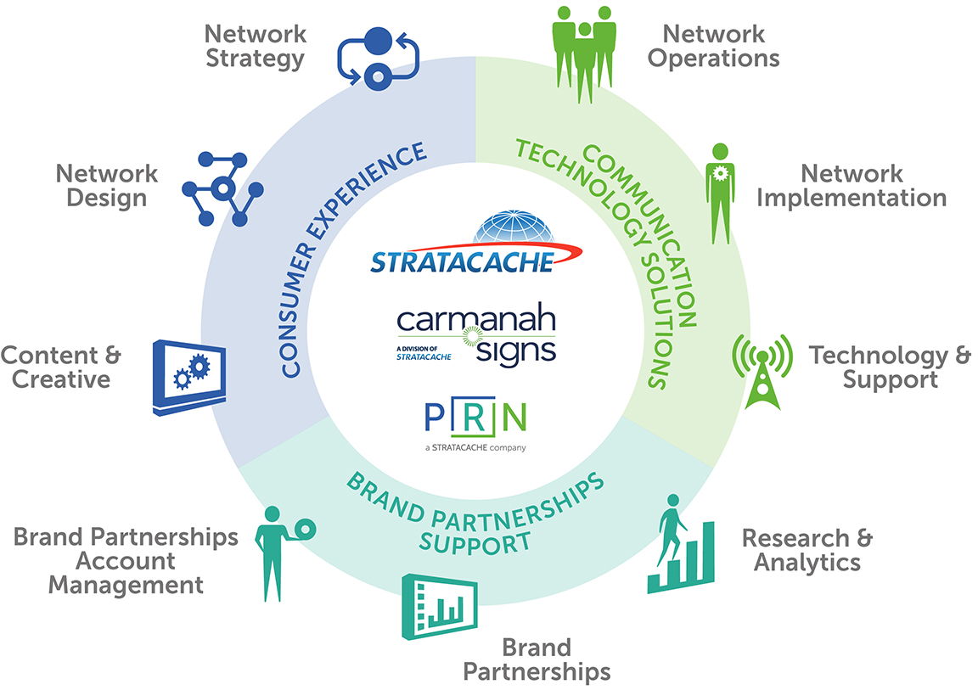
Pragmatism Rules!
Beginning the Process with a Practical Assessment
APPROACH
End-to-end
Holistic
Strategic
Lean Startup – Practical
FOCUS
Stakeholders
Goals & KPI’s
Advanced Flexible Technology
Experience Centric
ROI/ROO – Bottom Line
Notes:
We get why it’s a challenge to think scale – to cross over from “SOF” to “SON”
That’s why
LORI
But technology is just a vessel – screens don’t do the heavy lifting. Smart content built around an editorial calendar that unifies all local and national marketing, good works, and localized efforts is the key – creating an editorial calendar (distinct from a marketing calendar) and leveraging key customer triggers like
What’s new
Seasonality
Good works
and Branch of the community
Is what really moves the needle!

Slide 23
Thank You!

